Slide 1
Office 365 Development

Slide 2
Cordova Development with Office 365​ APIs in Visual Studio 2013
Speaker
Speaker

Slide 3

Agenda
Cordova Overview
Developing Cordova Apps
Cordova Apps and Office 365
Cordova Apps and AngularJS

Slide 4
Developer vision
USERS
DATA
HTML
Notes:
Our Office 365 developer vision focuses on the Users’ experience and their data. As a developer you can bring your applications into their user experience. With over 1.2+ billion users of Office Worldwide, this is a huge opportunity to provide a window into your applications. As well as being able to connect into their data and add intelligence to your applications. There are currently 850 million events created a month and a total of 470Pb+ of data stored in the service that can add value to for our Users’.

Slide 5
Cordova Overview

Slide 6
What is a Hybrid App?
An app created with HTML5, CSS3 and JavaScript
Available through an app store
Different than a mobile web site
Hybrid app runs in browser of mobile device
Chromeless (no browser title bar, navigation buttons, etc.)
HTML, CSS and JavaScript downloaded and run locally from device
App launched in full screen mode
User isn’t aware that app is using browser

Slide 7
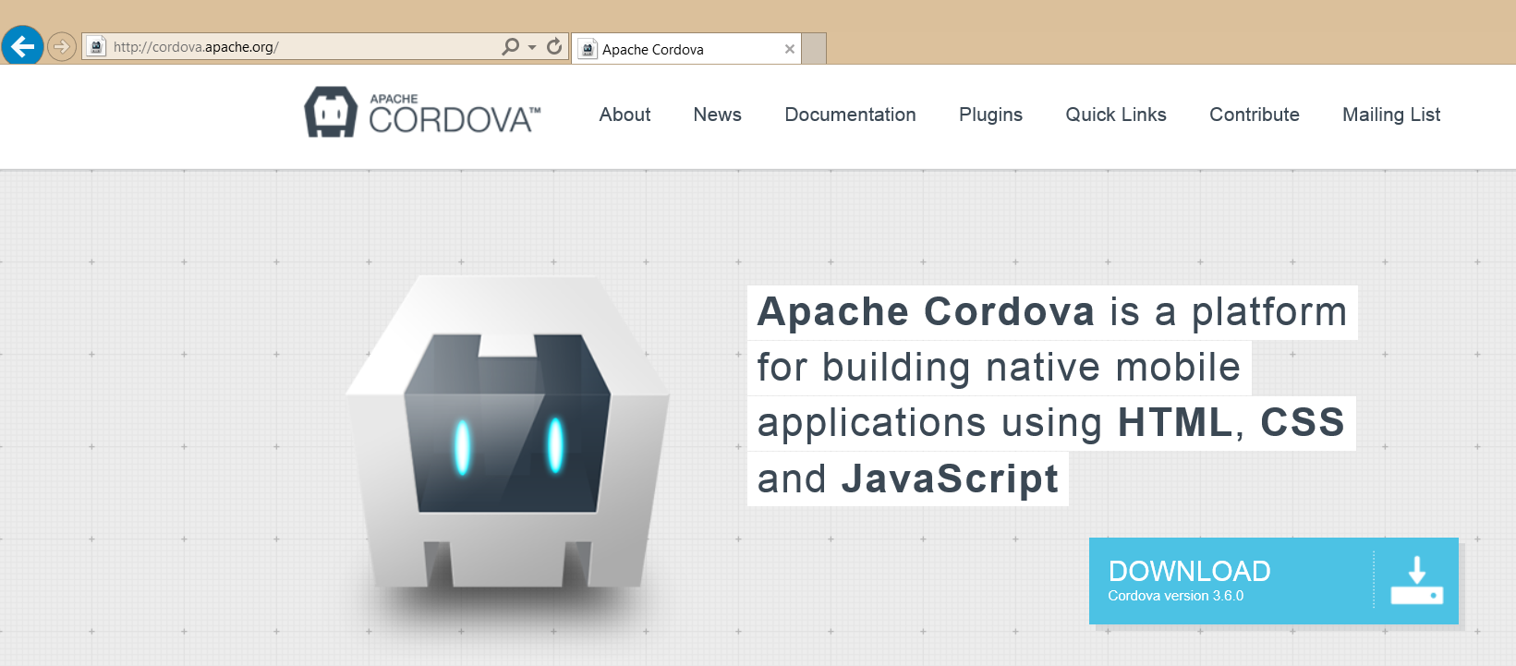
What is Cordova?
A platform for developing hybrid apps with HTML, CSS and JavaScript
An open source collection of JavaScript device APIs
Something that abstracts away device specific APIs
Toolsets built on top of Cordova
PhoneGap (Abode)
AppBuilder (Telerik)

Slide 8
Cordova in Visual Studio
MS Open Tech maintains Windows devices support
http://msopentech.com/apache-cordova
Provides developer environment support for CLI and Visual Studio
Command Line tools (CLI)
most popular amongst Web developers
can use PhoneGap Build service to build across platforms
Visual Studio integration (MDD)
Full integration with Visual Studio including emulators, cross-debugging, etc.
Builds for iOS, Android, Windows Phone and Windows Store

Slide 9
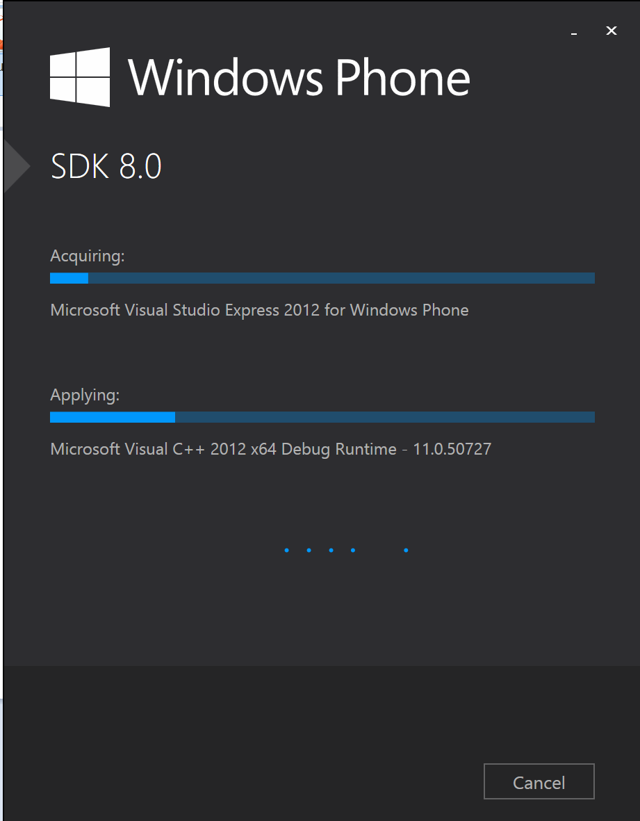
Setting Up Your Developer Environment
Installation Documentation
http://msdn.microsoft.com/en-us/library/dn757054.aspx
http://www.visualstudio.com/en-us/explore/cordova-vs.aspx
Setup Overview
Windows 7, 8.1 or Windows Server 2012 R2
Visual Studio 2013 with Update 4 with Windows Phone SDK
Visual Studio Tools for Apache Cordova CTP 3.0

Slide 10
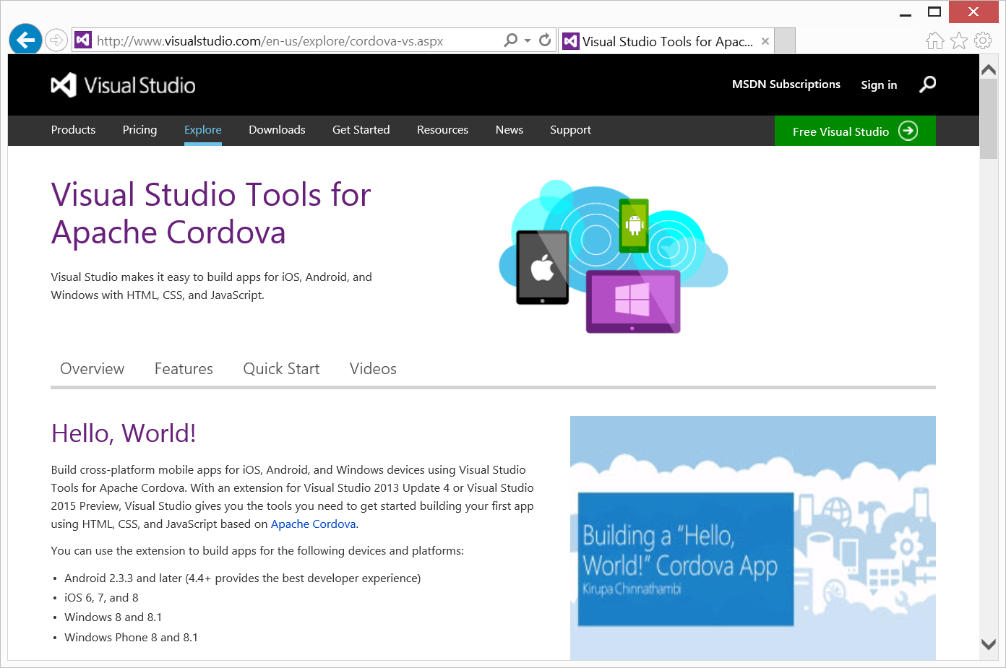
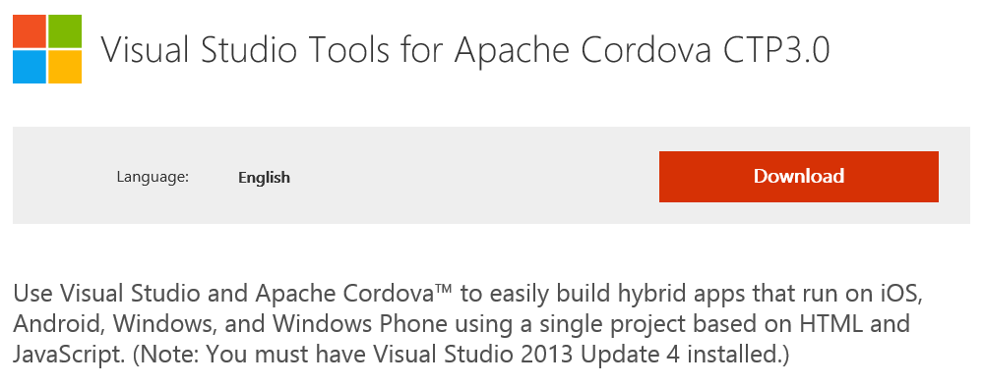
Visual Studio Tools for Apache Cordova

Slide 11
Developing Cordova Apps

Slide 12
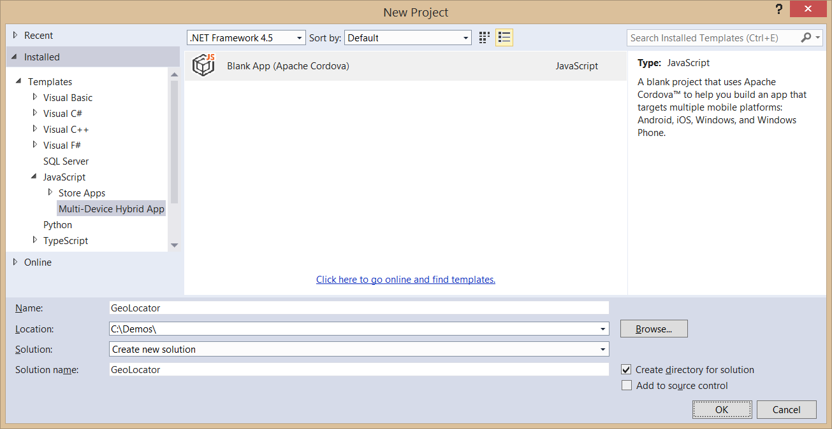
Creating a Cordova App
Use the Blank App (Apache Cordova) template
Templates > JavaScript > Multi-Device Hybrid Apps

Slide 13
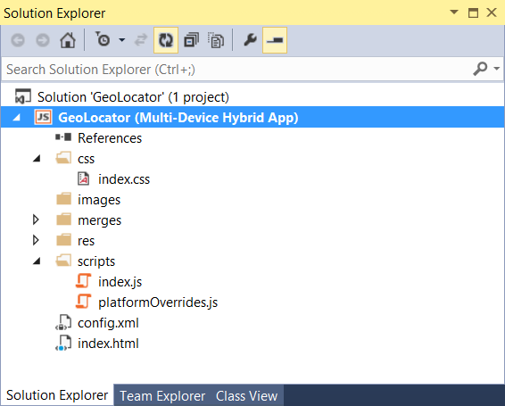
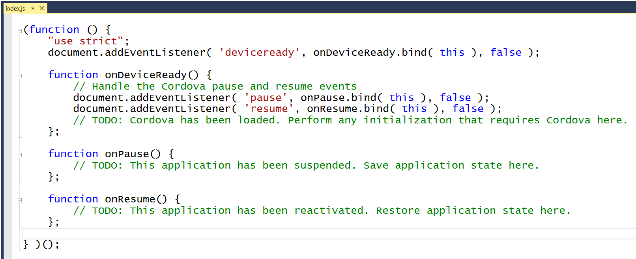
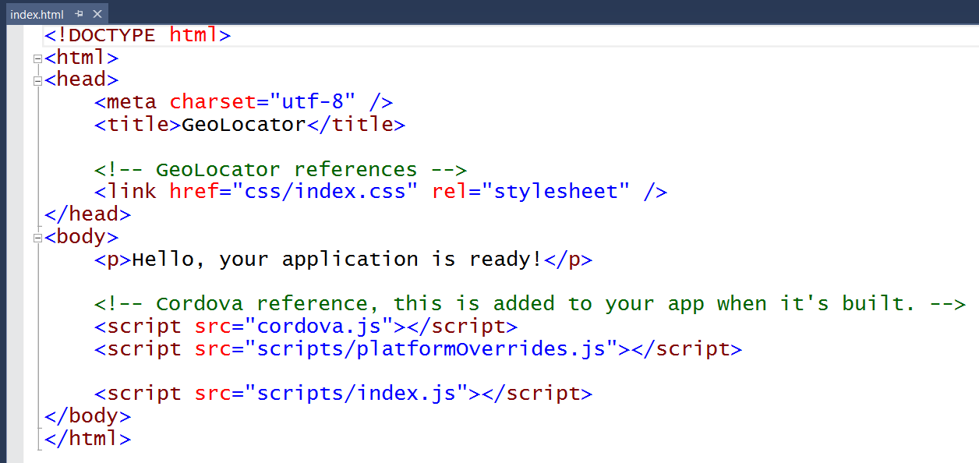
Cordova App Starting Point

Slide 14
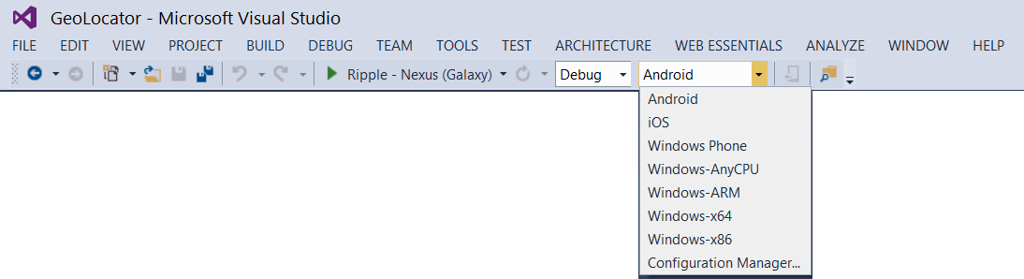
Selecting a Debug Target
Android
Windows Phone
Other Windows Devices

Slide 15
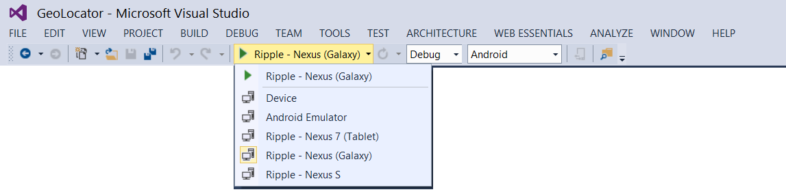
Android Emulators and Debugging
Apache Ripple emulator
Android emulator
Genymotion emulator
Android device

Slide 16
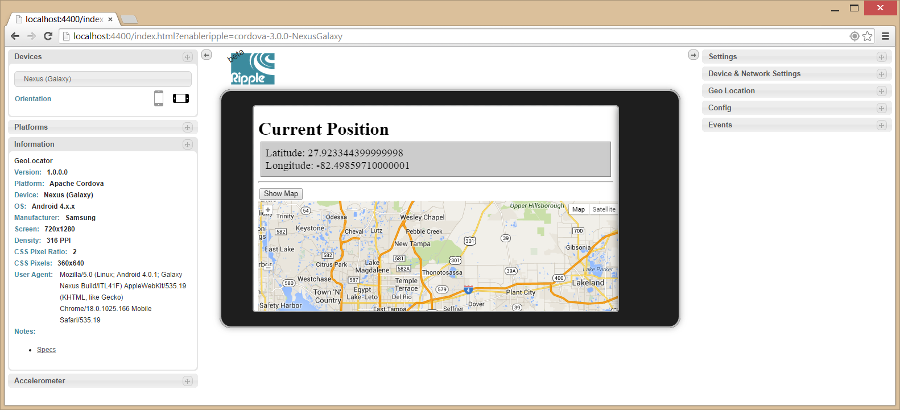
Debugging with Ripple
Included with Android SDK
Runs inside Chrome browser

Slide 17
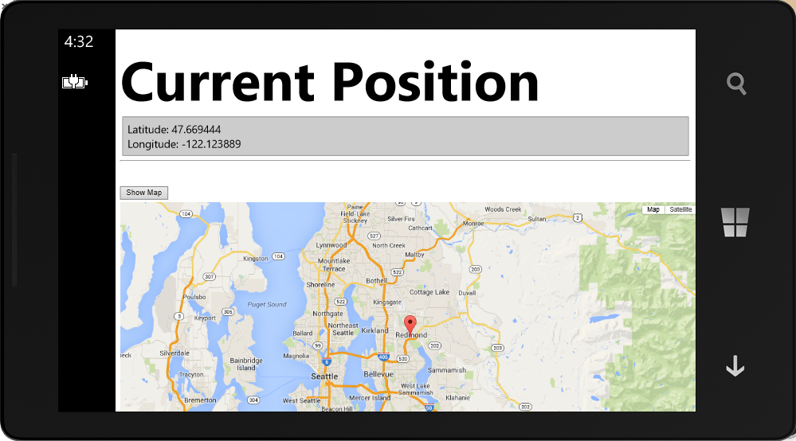
Debugging with Windows Phone
You can use a Windows Phone emulator
You can use an attached Windows Phone device

Slide 18
Creating and Running a Cordova App Project

Slide 19
Cordova Apps and Office 365

Slide 20
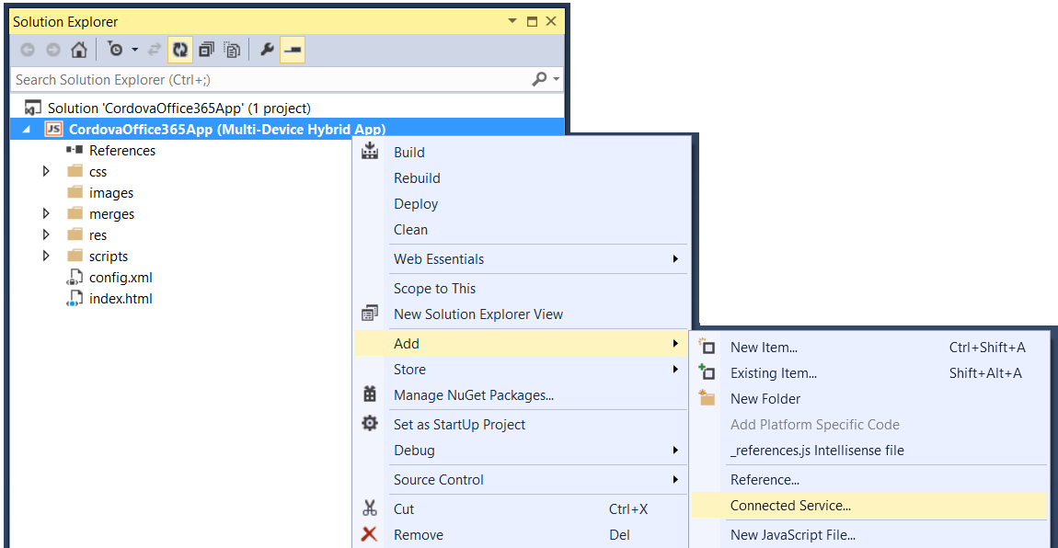
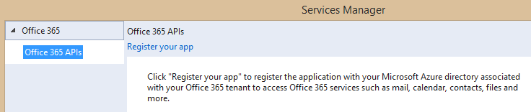
Adding Connected Services
1
Project > Add > Connected Service…
2
Register your app

Slide 21
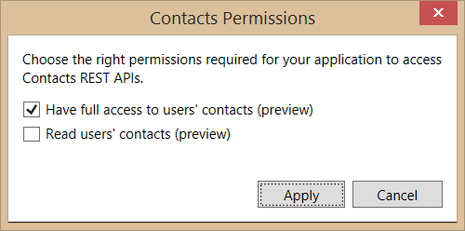
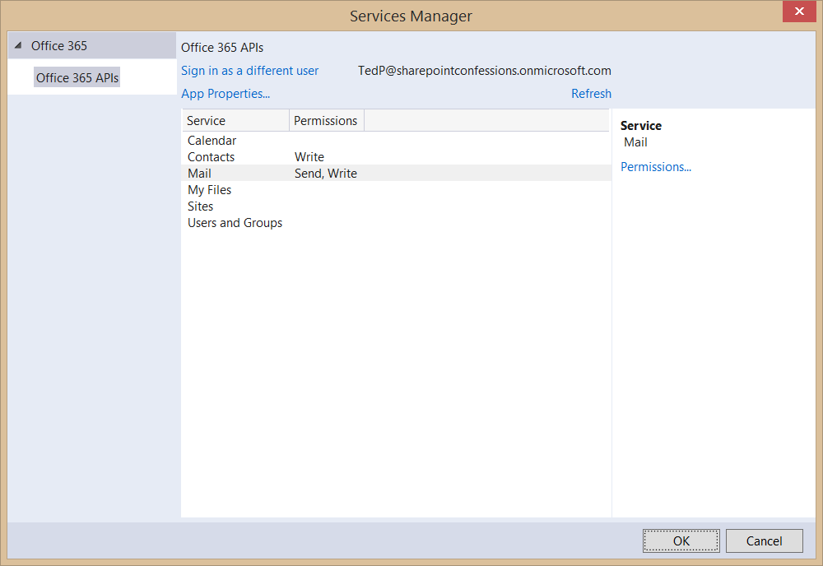
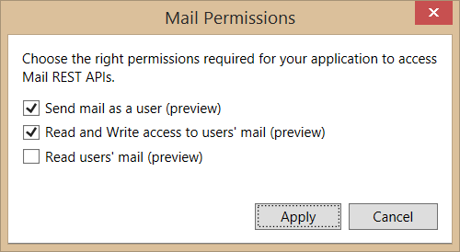
Connected Services Permissions
3
Select required app permissions

Slide 22
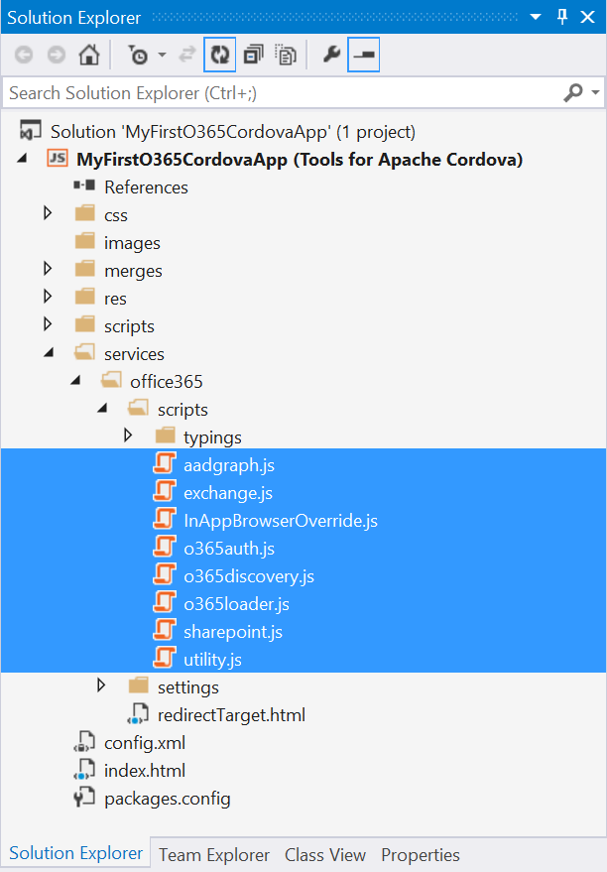
Office 365 API Libraries
Added with Connected Service
Provides JS libraries for AAD authentication
Provides JS libraries for accessing Exchange
Provides JS libraries for accessing SharePoint

Slide 23
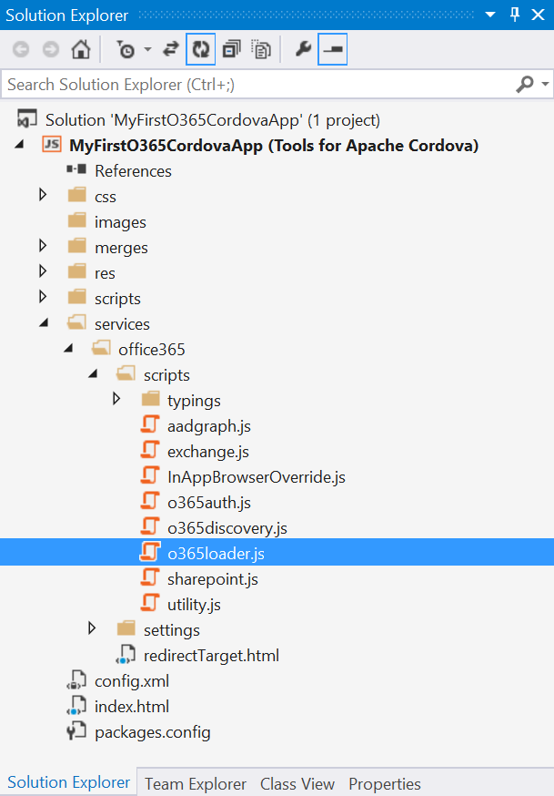
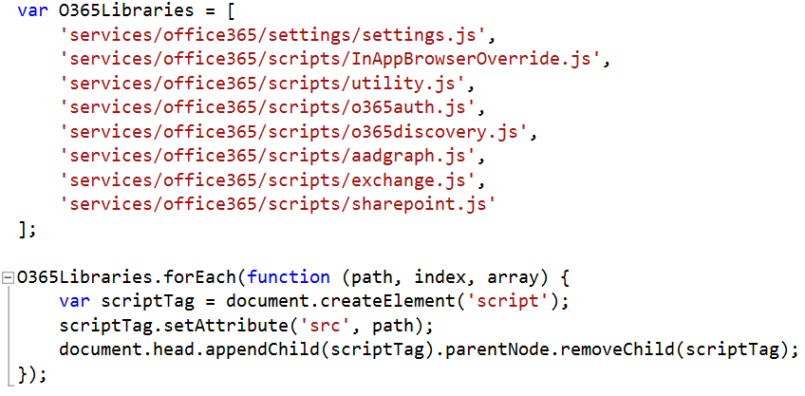
Loading Scripts in o365loader.js
o365loader.js adds O365 scripts to page

Slide 24
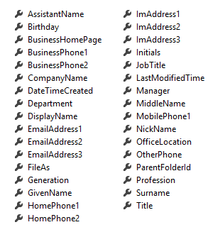
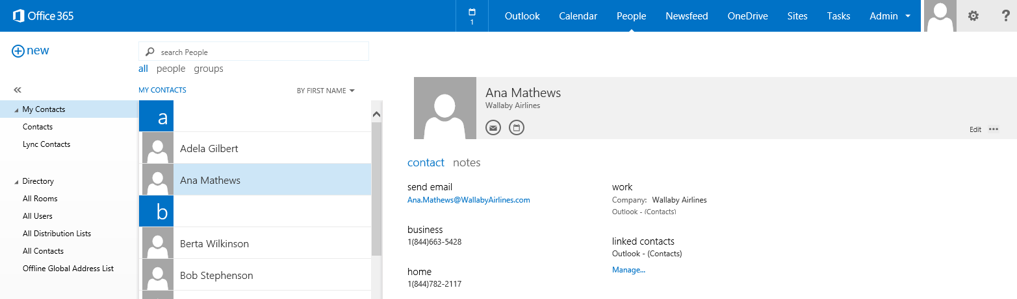
Contacts
Common API operations
Reading contacts
Searching for contacts
Creating contacts
Deleting contacts
Editing events
Contact

Slide 25
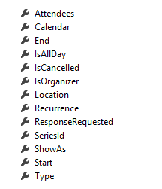
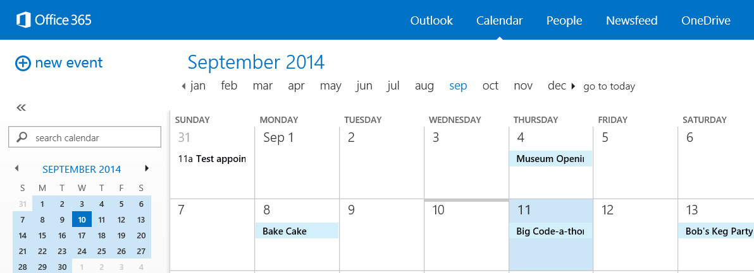
Calendar Events
Common API operations
Reading events for specific date range
Creating events
Deleting events
Editing events
Event

Slide 26
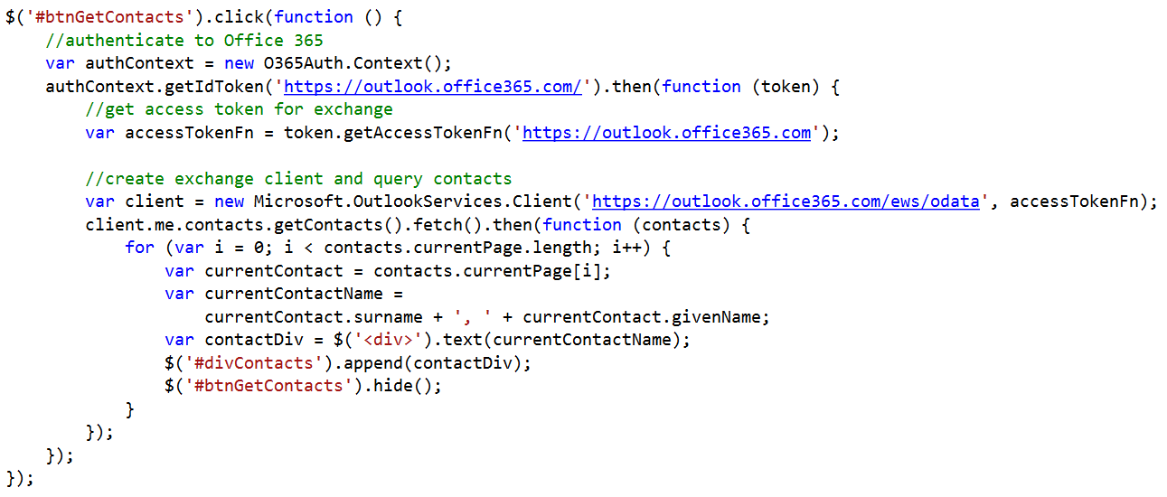
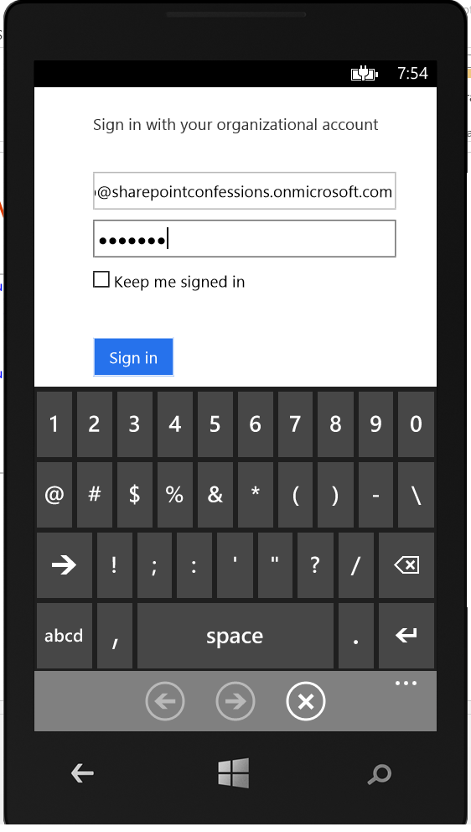
Connecting with the Office 365 APIs

Slide 27
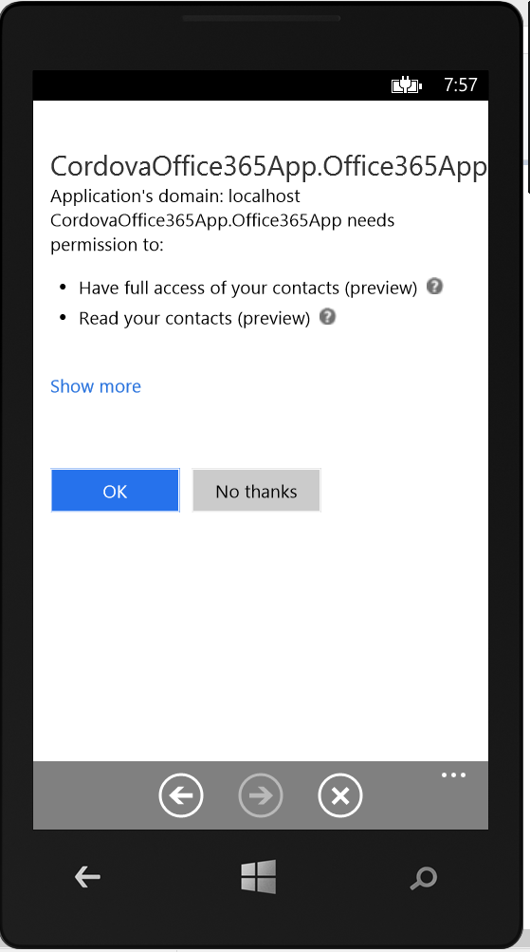
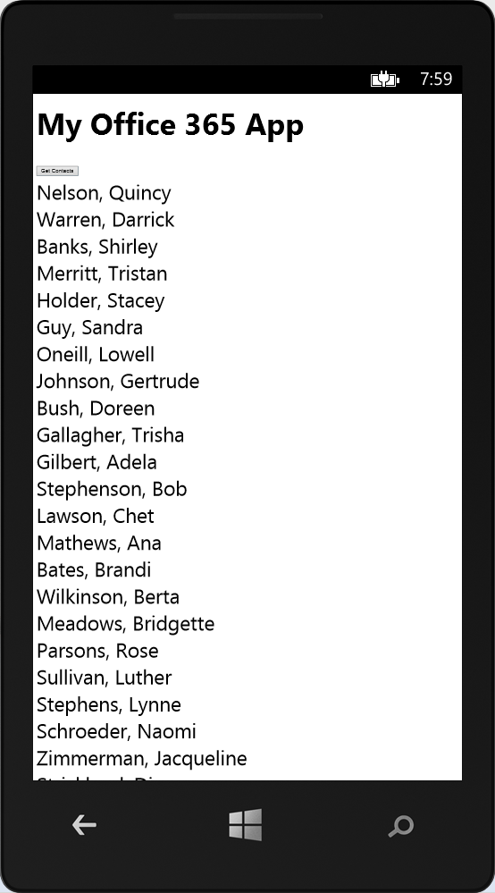
Testing the App using Windows Phone

Slide 28
demo
Examining the CordovaOffice365API App Project

Slide 29
Cordova Apps and AngularJS

Slide 30
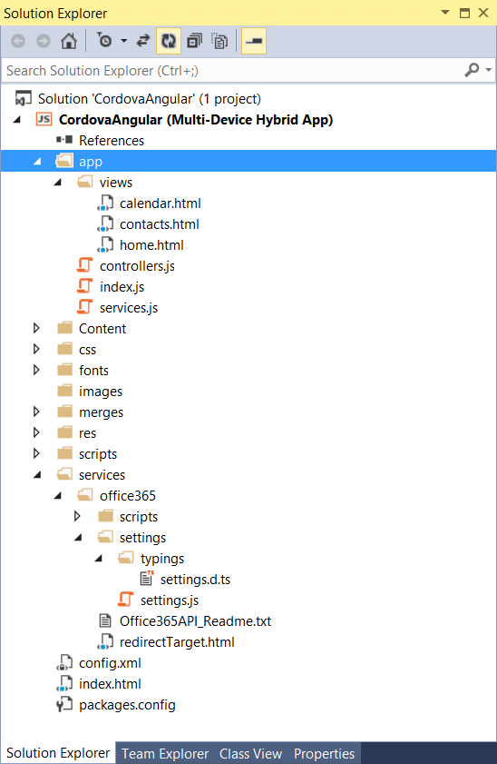
Structure of an Cordova/Angular App

Slide 31
demo
Examining the CordovaAngular project

Slide 32
Summary
Cordova Overview
Developing Cordova Apps
Cordova Apps and Office 365
Cordova Apps and AngularJS

Slide 33
Developer Program Launch
1 YEAR FREE
E-mail Newsletters
Free Developer Subscription
Free Training
Free Tools
Webinars
http://dev.office.com/devprogram

Slide 34


Engage
Office 365 Network
https://www.yammer.com/itpronetwork
Twitter
S
S
t
t
a
a
r
r
t
t
@OfficeDev
Stack overflow
[ms-office]
Channel 9 Dev Show
http://aka.ms/O365DevShow
Podcasts http://dev.office.com/podcasts
Snack Demos
http://aka.ms/o365DevSnackDemos
UserVoice
http://officespdev.uservoice.com/

